Slide 1
Unit 1
Requirement Analysis and System Modeling

Slide 2
REQUIREMENT ENGINEERING
A requirement is a feature of the system or a description of something the system is capable of doing in order to fulfill the system’s purpose.
Requirements describe the “what” of a system, not the “how.”
Requirements engineering produces one large document, written in a natural language, and contains a description of what the system will do without describing how it will do it.
Requirements engineering is the systematic use of proven principles, techniques, and language tools for the cost-effective analysis, documentation, and on-going evaluation of the user’s needs and the specifications of the external behavior of a system to satisfy those user needs.
It can be defined as a discipline, which addresses requirements of objects all along a system-development process.

Slide 3
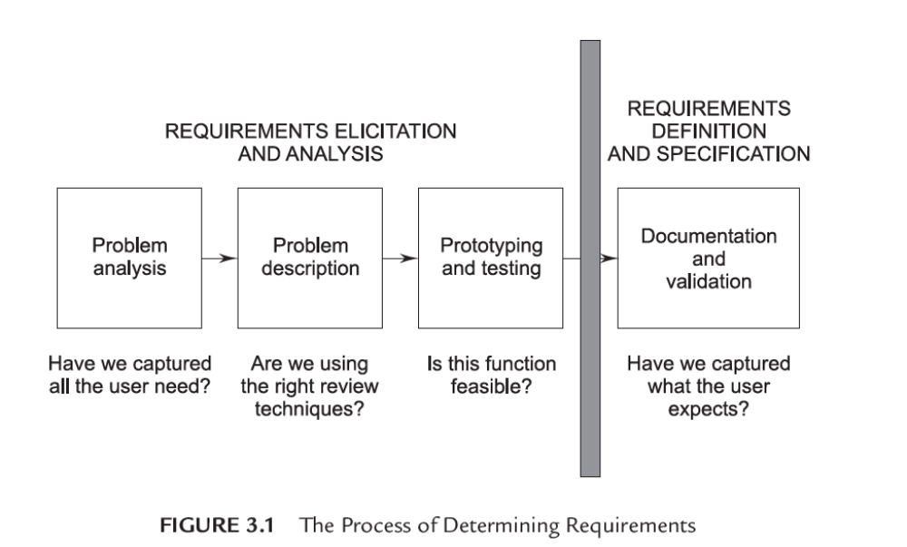
Figure 3.1 illustrates the process of determining the requirements for a software-based system.

Slide 4
The input to requirements engineering is the problem statement prepared by the customer.
The output of the Requirements Engineering (RE) process is a system requirements specification called the Requirement Definition and Description (RDD).
The system requirements specification forms the basis for designing software solutions.

Slide 5
PROCESS OF REQUIREMENTS ENGINEERING
Requirements engineering consists of the following processes:
Requirements gathering (elicitation).
Requirements analysis and modeling.
Requirements documentation.
Requirements review.
Requirements management.

Slide 6
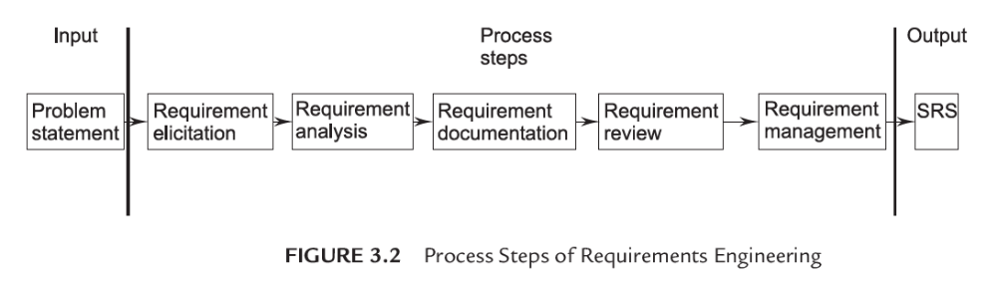
Figure 3.2 illustrates the process steps of requirements engineering.

Slide 7
a) Requirement Elicitation/Gathering.
Requirement gathering is a communication process between the parties involved and affected in the problem situation.
The tools in elicitation are meetings, interviews, video conferencing, e-mails, and existing documents study and facts findings. More than 90% to 95% elicitation should be complete in the initiation stage while the remaining 5% is completed during the development life-cycle.
The requirements are gathered from various sources.
The sources are:
Customer (Initiator)
End Users
Primary Users
Secondary Users
Stakeholders

Slide 8
b) Requirement Analysis
Requirement analysis is a very important and essential activity after elicitation.
In this phase, each requirement is analyzed from the point-of-view of validity, consistency, and feasibility for firm consideration in the RDD and then in the SRS.
Validity confirms its relevance to goals and objectives and consistently confirms that it does not conflict with other requirements but supports others where necessary.
Feasibility ensures that the necessary inputs are available without bias and error, and technology support is possible to execute the requirement as a solution. This portion of the analysis confirms the place of the requirements in RDD on its own and along with others.
The second portion of analysis attempts to find for each requirement, its functionality, features, and facilities and the need for these under different conditions and constraints.
Functionality states “how to achieve the requirement goal.” Features describe the attributes of functionality, and facilities provide its delivery, administration, and communication to other systems.

Slide 9
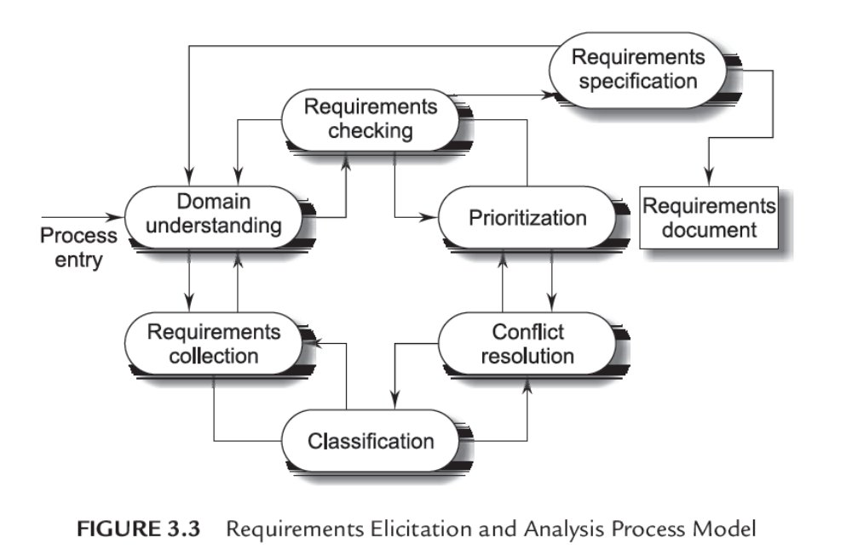
Process Model of Elicitation and Analysis

Slide 10
The process activities are:
1. Domain Understanding. Analysts must develop their understanding of the application domain. For example, if a system for a supermarket is required, the analyst must find out how supermarkets operate.
2. Requirements Collection. This is the process of interacting with stakeholders in the system to discover their requirements. Obviously, domain understanding develops further during this activity.
3. Classification. This activity takes the unstructured collection of requirements and organizes them into coherent clusters.
4. Conflict Resolution. Inevitably, where multiple stakeholders are involved, requirements will conflict. This activity is concerned with findings and resolving these conflicts.
5. Prioritization. In any set of requirements some priorities will be more important than others. This stage involves interaction with stakeholders to discover the most important requirements.
6. Requirements Checking. The requirements are checked to discover if they are complete, consistent, and in accordance with what stakeholders really want from the system.

Slide 11
c) Requirements Documentation
Requirements documentation is a very important activity, which is written after the requirements elicitation and analysis. This is the way to represent requirements in a consistent format. The requirements document is called the Software Requirements Specification (SRS).

Slide 12
d) Requirements Review
A requirements review is a manual process, which involves multiple readers from both client and contractor staff checking the requirements document for anomalies and omissions.
A requirements review can be informal or formal.

Slide 13
1. Informal Review. Informal reviews simply involve contractors discussing requirements with as many system stakeholders as possible. It is surprising how often communication between system developers and stakeholders ends after elicitation and there is no conformation that the documented requirements are what the stakeholders really said they wanted. Many problems can be detected simply by talking about the system to stakeholders before making a commitment to a formal review.
2. Formal Review. In a formal requirements review, the development team should ‘walk’ the client through the system requirements, explaining the implications of each requirement. The review team should check each requirement for consistency and should check the requirements as a whole for completeness.

Slide 14
e) Requirements Management
Requirements management is defined as a systematic approach to eliciting, organizing, and documenting the requirements of the system, and a process that establishes and maintains agreement between the customer and project team on the changing requirements of the system.

Slide 15
SRS DOCUMENT
An SRS document is generated as the output of requirements analysis. Requirements analysis involves obtaining a clear and thorough understanding of the product to be developed.
Thus, the SRS should be a consistent, correct, unambiguous, and complete document. The developer of the system can prepare an SRS after detailed communication with the customer.
An SRS clearly defines the following:
External interfaces of the system: They identify the information that is to flow ‘from and to’ to the system.
Functional and non-functional requirements of the system: They are the findings of the run-time requirements.

Slide 16
The functional requirements of the system as documented in the SRS document should clearly describe each function, which the system would support along with the corresponding input and output data set.
The non-functional requirements deal with the characteristics of the system that cannot be expressed as functions. Examples of non-functional requirements include aspects concerning maintainability, portability, and usability. The non-functional requirements include aspects concerning maintainability, portability, and usability. The non-functional requirements may also include reliability issues, accuracy of results, human-computer interface issues, and constraints on the system implementation.

Slide 17
Organization of an SRS Document
1. Introduction
1.1 Purpose
1.2 Intended Audience
1.3 Intended Use
1.4 Scope
1.5 Definitions and Acronyms
2. Overall Description
2.1 User Needs
2.2 Assumptions and Dependencies
3. System Features and Requirements
3.1 Functional Requirements
3.2 External Interface Requirements
3.3 System Features
3.4 Nonfunctional Requirements

Slide 18
SRS VALIDATION
It is extremely important to detect errors in the requirements document before going to other phases of system development.
The major objective of SRS validation is to ensure that user requirements are complete and correctly recorded in the SRS and it is free from errors.
It is also needed to check that the SRS itself is of good quality.
Some of the most common types of errors in the SRS include:
1. Omission. Some user requirement is not included in the SRS. This error directly affects the external completeness of the system.
2. Inconsistency. Due to contradictions in requirements or incompatibility of state requirements.
3. Incorrect fact. Some facts recorded in the SRS are not correct.
4. Ambiguity. Some requirements have multiple meanings.
Besides improving the quality of the SRS, SRS validation should uncover and rectify all possible types of errors.

Slide 19
COMPONENTS OF SRS
The following requirements are used in the specification of the SRS:
1. Functional requirements
2. Performance requirements
3. Design constraints
4. External interface requirements

Slide 20
Functional Requirements
Functional requirements specify what output should be produced from the given inputs. So they basically describe the connectivity between the input and output of the system. For each functional requirement:
1. A detailed description of all the data inputs and their sources, the units of measure, and the range of valid inputs be specified:
2. All the operations to be performed on the input data obtain the output should be specified, and
3. Care must be taken not to specify any algorithms that are not parts of the system but that may be needed to implement the system.
4. It must clearly state what the system should do if system behaves abnormally when any invalid input is given or due to some error during computation. Specifically, it should specify the behaviour of the system for invalid inputs and invalid outputs.

Slide 21
Performance Requirements (Speed Requirements)
This part of an SRS specifies the performance constraints on the software system. All the requirements related to the performance characteristics of the system must be clearly specified. Performance requirements are typically expressed as processed transactions per second or response time from the system for a user event or screen refresh time or a combination of these. It is a good idea to pin down performance requirements for the most used or critical transactions, user events and screens.

Slide 22
Design Constraints
The client environment may restrict the designer to include some design constraints that must be followed. The various design constraints are standard compliance, resource limits, operating environment, reliability and security requirements and policies that may have an impact on the design of the system. An SRS should identify and specify all such constraints.
Standard Compliance: It specifies the requirements for the standard the system must follow. The standards may include the report format and according procedures.
Hardware Limitations: The software needs some existing or predetermined hardware to operate, thus imposing restrictions on the design. Hardware limitations can includes the types of machines to be used operating system availability memory space etc.
Fault Tolerance: Fault tolerance requirements can place a major constraint on how the system is to be designed. Fault tolerance requirements often make the system more complex and expensive, so they should be minimized.
Security: Currently security requirements have become essential and major for all types of systems. Security requirements place restriction s on the use of certain commands control access to database, provide different kinds of access, requirements for different people, require the use of passwords and cryptography techniques, and maintain a log of activities in the system.

Slide 23
External Interface Requirements
For each external interface requirements:
1. All the possible interactions of the software with people hardware and other software should be clearly specified,
2. The characteristics of each user interface of the software product should be specified and
3. The SRS should specify the logical characteristics of each interface between the software product and the hardware components for hardware interfacing.

Slide 24
CHARACTERISTICS OF SRS
1. Correctness: User review is used to ensure the correctness of requirements stated in the SRS. SRS is said to be correct if it covers all the requirements that are actually expected from the system.
2. Completeness: Completeness of SRS indicates every sense of completion including the numbering of all the pages, resolving the to be determined parts to as much extent as possible as well as covering all the functional and non-functional requirements properly.
3. Consistency: Requirements in SRS are said to be consistent if there are no conflicts between any set of requirements. Examples of conflict include differences in terminologies used at separate places, logical conflicts like time period of report generation, etc.
4. Unambiguousness: An SRS is said to be unambiguous if all the requirements stated have only 1 interpretation. Some of the ways to prevent unambiguousness include the use of modelling techniques like ER diagrams, proper reviews and buddy checks, etc.
5. Ranking for importance and stability: There should a criterion to classify the requirements as less or more important or more specifically as desirable or essential. An identifier mark can be used with every requirement to indicate its rank or stability.
6. Modifiability: SRS should be made as modifiable as possible and should be capable of easily accepting changes to the system to some extent. Modifications should be properly indexed and cross-referenced.

Slide 25
7. Verifiability: An SRS is verifiable if there exists a specific technique to quantifiably measure the extent to which every requirement is met by the system. For example, a requirement stating that the system must be user-friendly is not verifiable and listing such requirements should be avoided.
8. Traceability: One should be able to trace a requirement to a design component and then to a code segment in the program. Similarly, one should be able to trace a requirement to the corresponding test cases.
9. Design Independence: There should be an option to choose from multiple design alternatives for the final system. More specifically, the SRS should not include any implementation details.
10. Testability: An SRS should be written in such a way that it is easy to generate test cases and test plans from the document.
11. Understandable by the customer: An end user maybe an expert in his/her specific domain but might not be an expert in computer science. Hence, the use of formal notations and symbols should be avoided to as much extent as possible. The language should be kept easy and clear.
12. Right level of abstraction: If the SRS is written for the requirements phase, the details should be explained explicitly. Whereas, for a feasibility study, fewer details can be used. Hence, the level of abstraction varies according to the purpose of the SRS.

Slide 26
